Slide 1
Preschool Professional Course
ECCE
Module 2
Integrated and Collaborative Learning

Slide 2
Integrated and Collaborative learning
Integrated and Collaborative learning is the educational approach of using groups to enhance learning through working together. Groups of two or more learners work together to solve problems, complete tasks, or learn new concepts.
This approach actively engages learners to process and synthesize information and concepts, rather than using rote memorization of facts and figures.
Learners work with each other on projects, where they must collaborate as a group to understand the concepts being presented to them.
Through defending their positions, reframing ideas, listening to other viewpoints and articulating their points, learners will gain a more complete understanding as a group than they could as individuals.

Slide 3
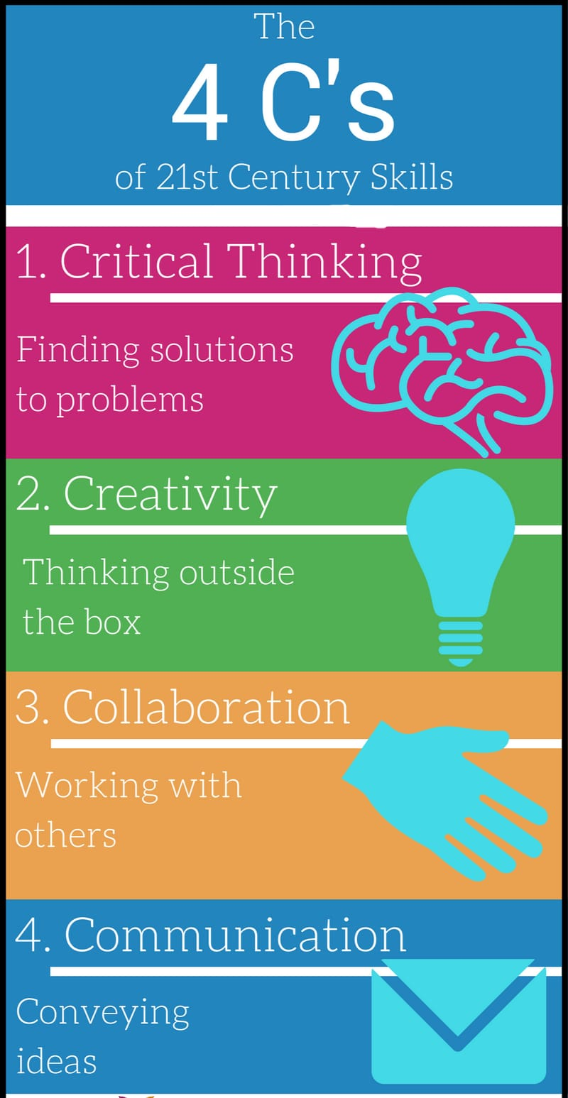
21st Century Skills

Slide 4
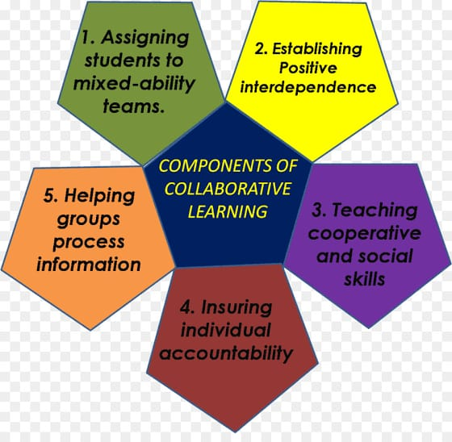
Components

Slide 5
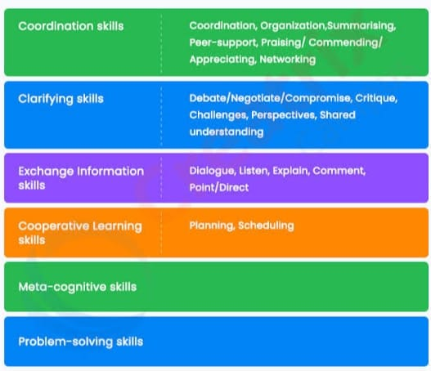
Skills Identification in Integrated Collaborative Learning

Slide 6
Why use integrated collaborative learning?

Slide 7
Pupil’s learn qualities of humility, self control, fair play, patience and leadership.
Builds pupil’s confidence and character.
Promote pupil’s learning and academic achievement.
Enhance pupil’s satisfaction with their learning experience.
Help pupil’s develop skills in oral communication.
Develop pupil’s social skills.
Promote pupil’s self-esteem.
Increase pupil retention.
Develop a community of learners.

Slide 8
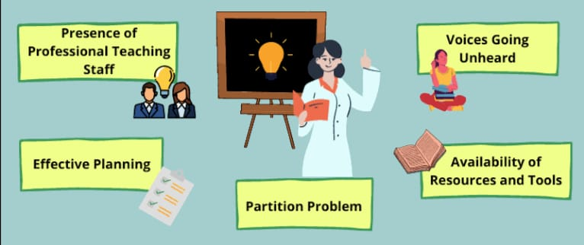
Challenges of Integrated collaborative teaching

