Slide 1
Preschool Professional Course
ECCE
Module 3
Teaching Methodologies

Slide 2
Different Teaching Methodologies
Basic methodologies
Teacher-centered methods
Learner centered methods
Content focused methods
Interactive/participative methods

Slide 3
1. Teacher-Centered Instruction
The teacher-centered methodology is based on the idea that the teacher has the main responsibility in the learning environment. Teachers are in charge of the classroom and direct all activities.

Slide 4
2. Small Group Instruction
Small group instruction (SGI) usually follows whole group instruction and provides students with a reduced student-teacher ratio, typically in groups of four to six students.

Slide 5
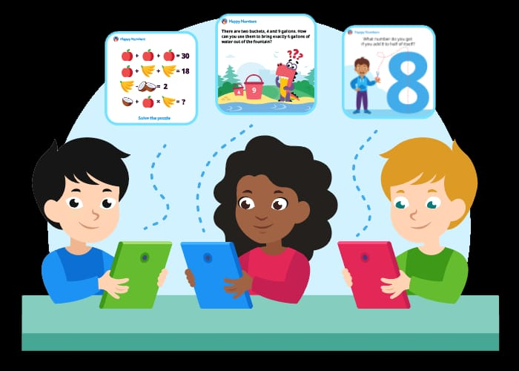
3. Student-Centered / Constructivist Approach
As we consider shifting the focus from teacher to students, the idea of a student-centered approach has become more popular, and there are good reasons for that.
Develops self confidence
Polishes skills
Develops Independence

Slide 6
4. Project-Based Learning
Project-based learning falls within the student-centered approach. As the name suggests, in project-based learning students complete projects. However through these projects students acquire
Knowledge
research
think critically
evaluate
analyze
make decisions
collaborate, and more. .

Slide 7
5. Montessori
This type of teaching is based on a methodology that’s over 100 years old. It is a student-centered method.
The Montessori method also encourages the use of “materials” .
In this method, the teacher prepares an ideal classroom environment full of activities that children may pick from to work on.

Slide 8
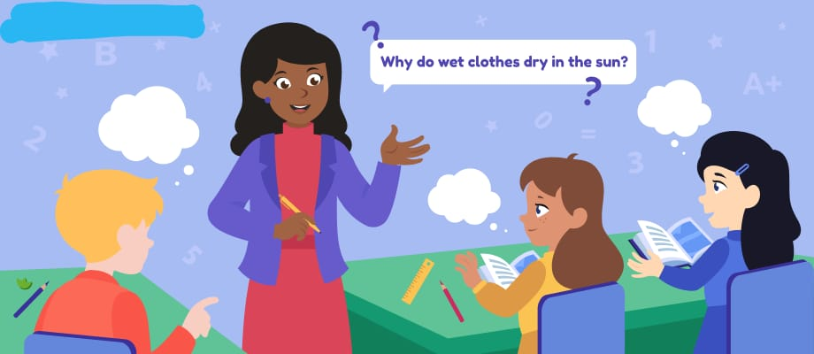
6. Inquiry-Based Learning
What if learning was question-driven? This is exactly what inquiry -based learning is about: it engages students by making real-world connections through exploration and high-level questioning.

Slide 9
7. Flipped Classroom
The concept of delivering online lectures that students can view from home to substitute lecturing in the classroom is known as flipped learning.

Slide 10
8. Cooperative Learning
As the name suggests, cooperative learning involves a lot of group work. However, it also requires a lot of structure and intervention on the part of the teacher to make learning as effective as possible.

Slide 11
9. Personalized Education
Personalized education takes the student-centered approach to a new level by, as much as possible, responding to each individual learner’s unique needs, strengths, and weaknesses.

Slide 12
What Is the Best Method of Teaching?
There is no “best” method of teaching.
The bottom line is that each teacher needs to find a teaching style that fits his or her personality.

