Slide 1
Preschool Professional Course
Montessori
Module 3
Sensorial

Slide 2
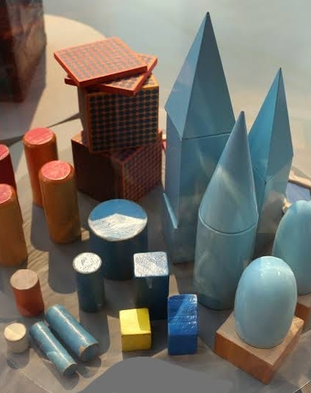
Sensorial
Sensorial is used in a Montessori classroom to develop the five senses: sight, listening, touch, taste, and smell. Montessori Sensorial activities help children to think cognitively.

Slide 3
Learning
Children learn through experiences, and by engaging in Montessori Sensorial activities, children are able to differentiate between sizes ,colors,orders,smells,tastes and sounds.

Slide 4
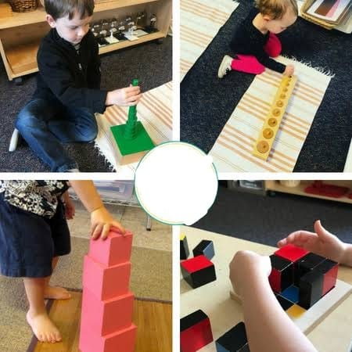
Visual Sense
Montessori categorizes the things children see with the visual sense further by separating them into
Dimension (size, length, width, and breadth of objects)
Color/Chromatic (color awareness)
Form (shape awareness).

Slide 5
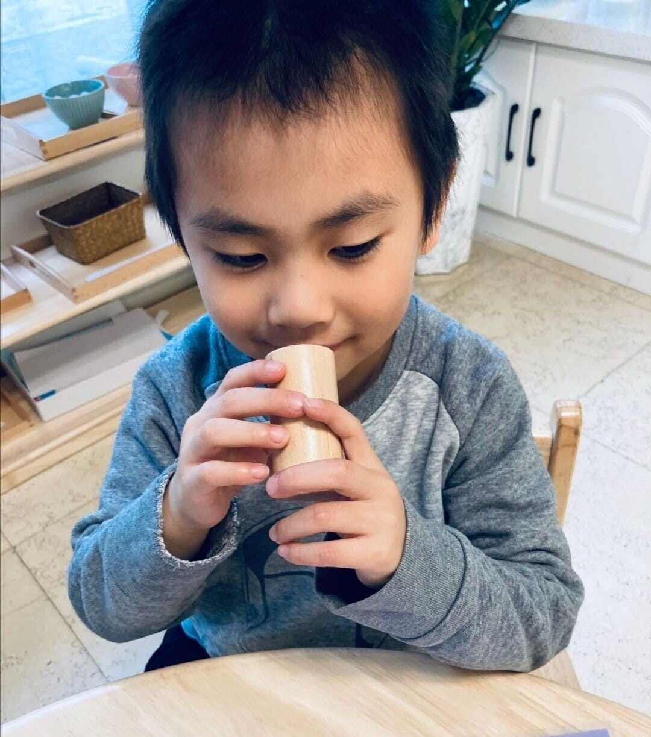
Sense of Smell/Olfactory
Olfactory is used in a Montessori class to develop children’s sense of smell .You will often present The Smelling Bottles activity to teach children about the different smells in their environment.

Slide 6
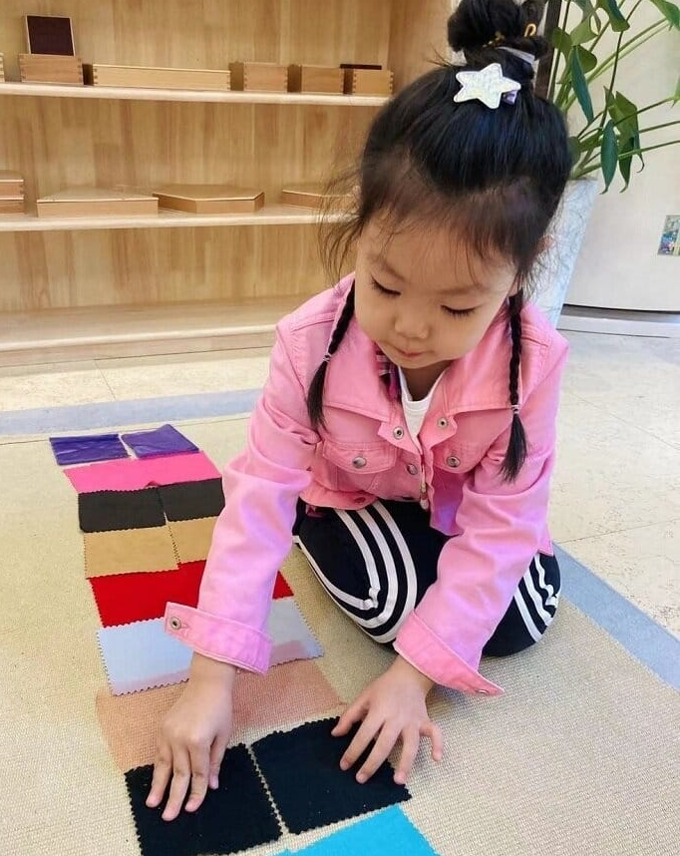
Sense of Touch/Tactile
Tactile in Montessori is all about touch. Children are encouraged to touch different textures and, by using their sense of touch, heighten their perception and understanding of the world around them.
As Maria Montessori said - “The hands are the instruments of the mind”.

Slide 7
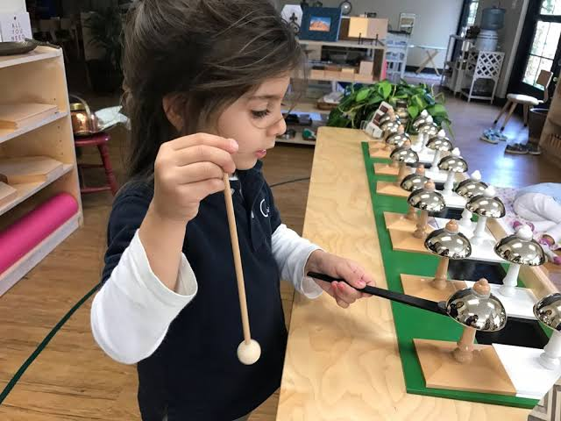
Auditory/Sense of Hearing
Auditory is used in Montessori to heighten our children’s sense of sound and recognize them.
Montessori Bells
Sound Cylinders are wonderful activities in Sensorial to help develop this sense in our children.

Slide 8
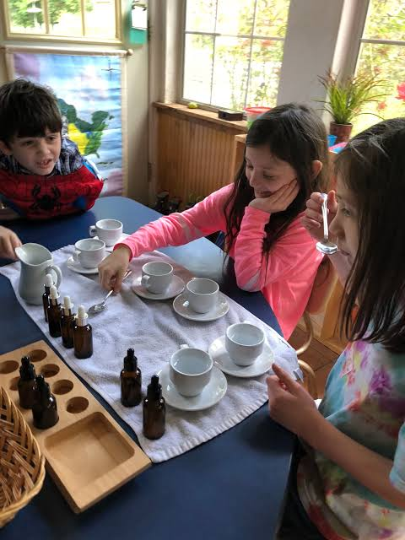
.
Gustatory/Sense of Taste
Gustatory is used in a Montessori classroom to help children differentiate different foods by different tastes.
Sour
Bitter
Sweet
Salty
.

Slide 9
