Slide 1
Preschool Professional Course
Montessori
Module 2 Exercises of Practical Life (EPL)

Slide 2
Exercises of Practical Life (EPL)
Exercises of Practical Life are those simple, daily performed activities which adults carry out in their environment in order to maintain proper conditions.

Slide 3
EPL is categorized in:
Elementary Movements
Care for The Environment
Care for Oneself
Care for Others

Slide 4
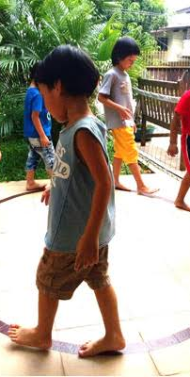
Elementary Movements
Holding, Carrying, Putting down, picking up, etc. of all that forms part of his daily environment, walking, sitting down, getting up, etc.

Slide 5
Care for the Environment
Activities like dusting, cleaning, washing, polishing, planting trees, etc.

Slide 6
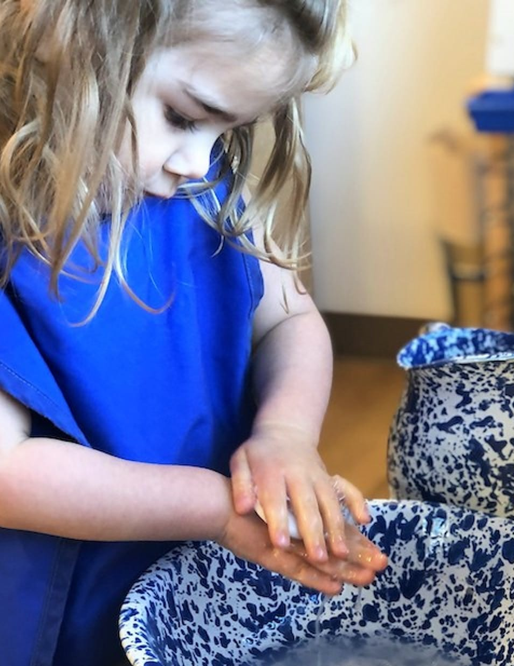
Looking After oneself
Dressing, undressing, bathing, combing, button snapping etc.

Slide 7
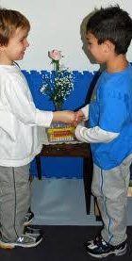
Care for others / Social relations
Greeting, Offering, Accepting, Table manners, Apologizing, All types of manners, etc.

Slide 8
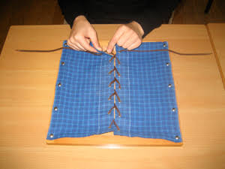
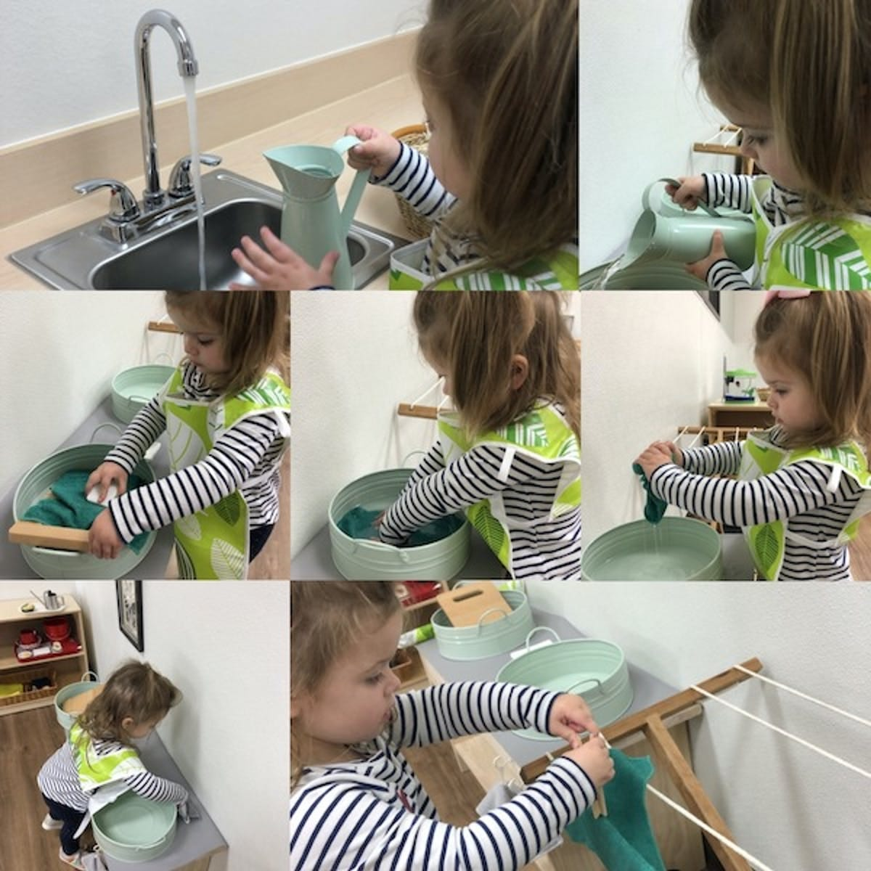
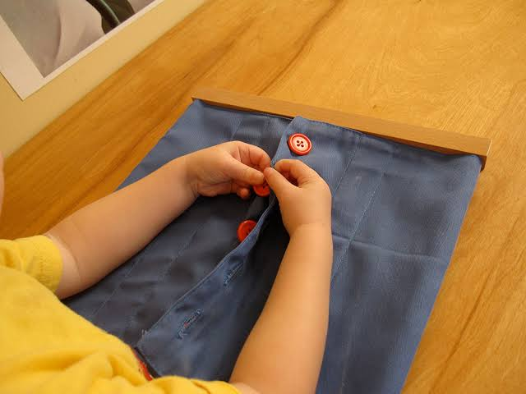
.
Some EPL Activities
.

Slide 9
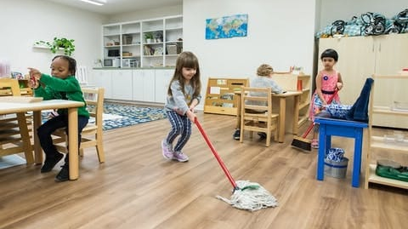
Presentation
There are 3 types of presentations for EPL depends on children’s need, nature of the activity. Collective Presentations Group Presentations Individual Presentations

Slide 10
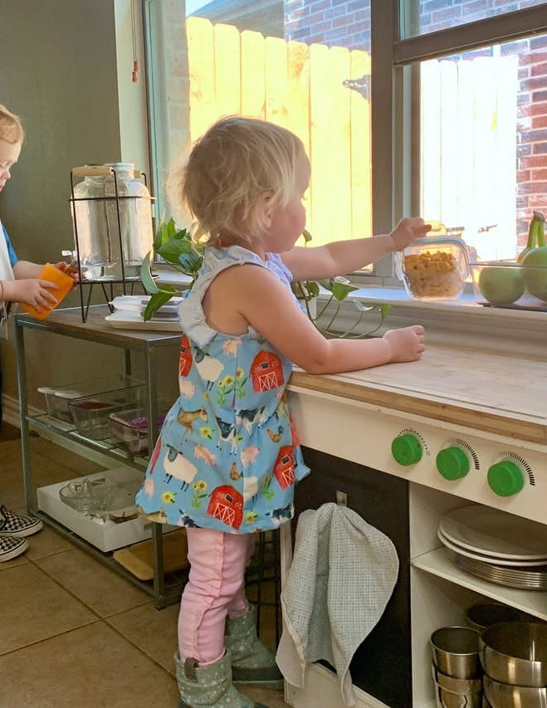
Importance / Significance of EPL
The child can develop: -A high level of concentration -A sense of order - Take pride in completing a job -Increase independence -Respect for his/her community and surroundings
-Improve fine motor skills
-Cognitive skills

Slide 11
