Slide 1
Preschool professional
Module 1
Instructor-Sidra Rauf
Area- STEM/STEAM Education
Topic-INTRODUCTION TO STEAM AND ITS BENEFITS

Slide 2
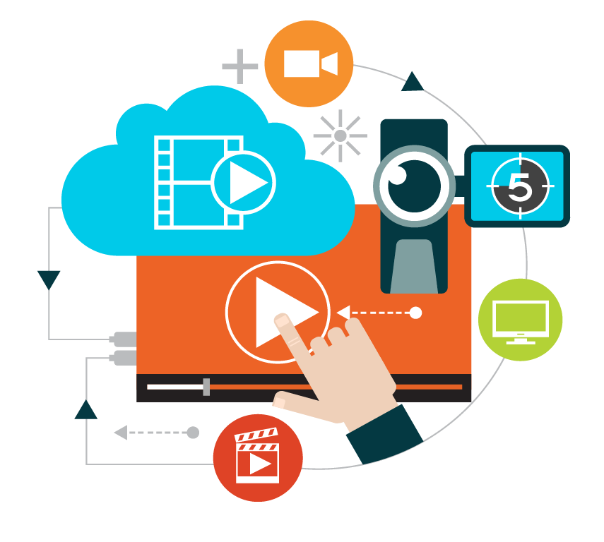
Course Content
Introduction to STEM/STEAM
The benefits of STEAM
STEM/STEAM Enterprise Skills
STEAM Learning process with Integrated Foundation

Slide 3
Course Objective
This course will enable you to:
Encourages original thinking and expression.
.Encourages collaborative and hands-on learning.
Children grow self-assurance.
.Encourages pupils to become change makers.

Slide 4
What is STEM?
STEM education is the intentional integration of science, technology, engineering, and mathematics.
As well as their associated practices, to create a student-centered learning environment.

Slide 5
What is STEAM
STEAM is a learning approach that guides student inquiry, conversation, and critical thinking via the application of Science, Technology, Engineering, the Arts, and Mathematics.

Slide 6
Benefits of STEAM
Every field is built on the STEAM concepts.
Critical thinking, asking excellent questions, observation, and discovery.
STEAM learning allows students and teachers to develop more real-world connections.
Students investigate and respond to authentic, interesting, and difficult issues, problems.
Challenges using open collaboration, communication, creativity.
Critical thinking to address small and large real-world problems.

Slide 7
STEM/STEAM Enterprise Skills
Team Work
Digital Literacy
Communication Skills
Problem Solving
Adaptability & Persistence
Creativity
Critical Thinking
STEAM Literacy

Slide 8
STEAM Learning process with Integrated Foundation

Slide 9
Thank You

