Slide 1
Preschool Professional Course
ECCE
Module 4
Dealing with slow learners

Slide 2
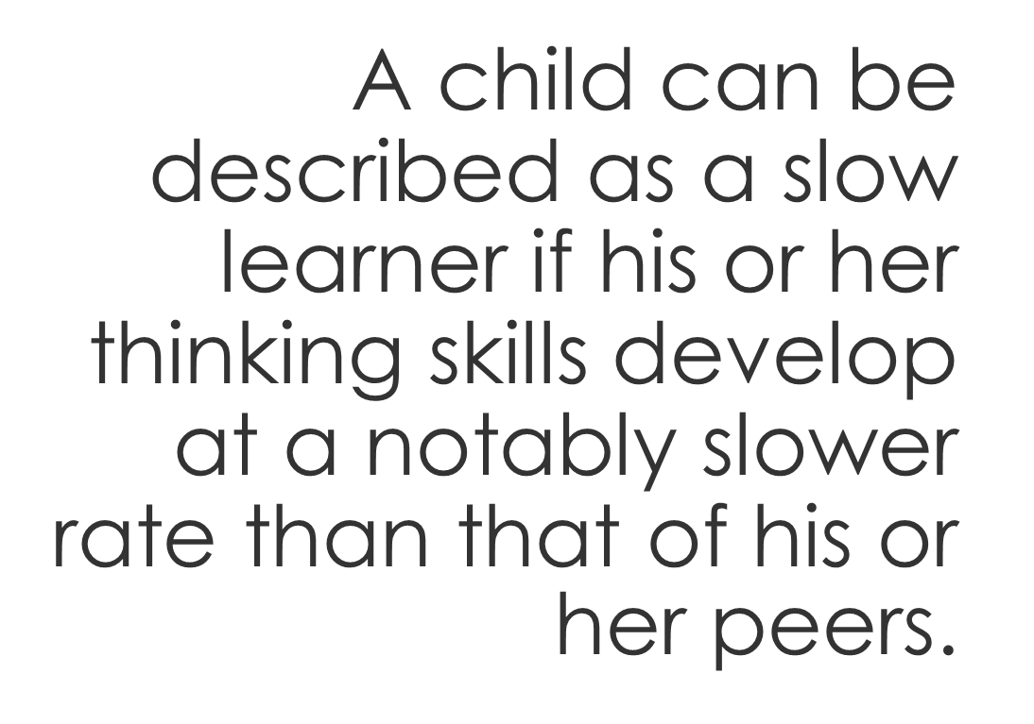
Who is a slow learner?

Slide 3
Characteristics of slow learners
Learning issues
Social issues
Auditory issues
Visual-motor issues
Language issues

Slide 4
Learning Issues
Slow learners tend to learn slower and are, in most cases, unable to retain what they learn. They also have a very short attention span.

Slide 5
Social Issues
They are self-conscious, tend to daydream a lot and love to spend time in solitude or in the company of younger children.

Slide 6
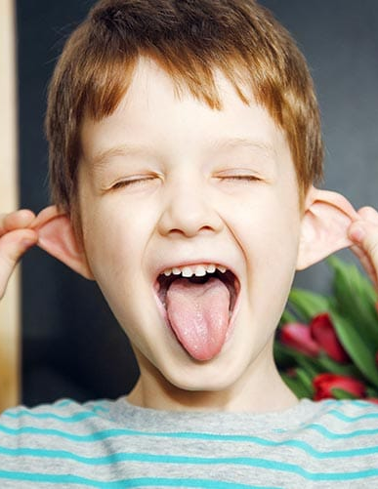
Auditory issues
Identification of sounds is difficult for slow learners and thus, provide irrelevant answers when a question is asked.

Slide 7
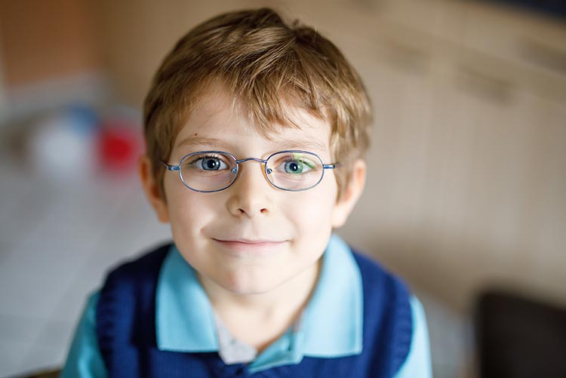
Slow learners with visual-motor issues prefer oral learning over visual learning. They find it difficult to differentiate between objects of different sizes, colour, and shape.
Visual-motor issues

Slide 8
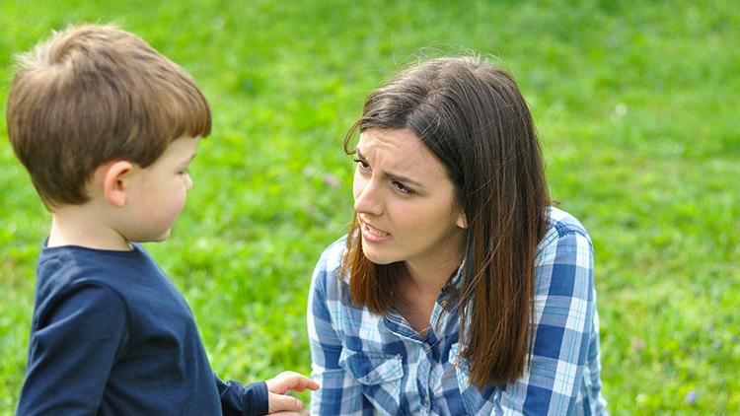
Language issues
Children who are slow learners find it hard to express themselves verbally and cannot articulate easily.

Slide 9
Tips to assist a slow learner
Be patient
Ask questions
Give him/her a quiet study table
Don’t let them give up
Don’t label them
Be easily accessible
Give small tasks

Slide 10
Teaching Ideas for Slow Learners
Drill
Multimodal Approach
Personalization
Mediated Learning

