Slide 1
Preschool Professional Course
ECCE
Module 5
Story Telling

Slide 2
Why Storytelling is Important
Stories can…
Enable children to empathies with unfamiliar people/places/situations.
Offer insights into different traditions and values.
Offer insights into universal life experiences.
Help children consider new ideas.
Reveal differences and commonalties of cultures around the world.

Slide 3
More benefits of Storytelling
Promote a feeling of well-being, fun and relaxation.
Increase children’s willingness to communicate thoughts and feelings.
Encourage active participation.
Increase verbal proficiency.
Encourage use of imagination and creativity.
Encourage cooperation between students.
Enhance listening skills.

Slide 4
Different ways of Storytelling

Slide 5
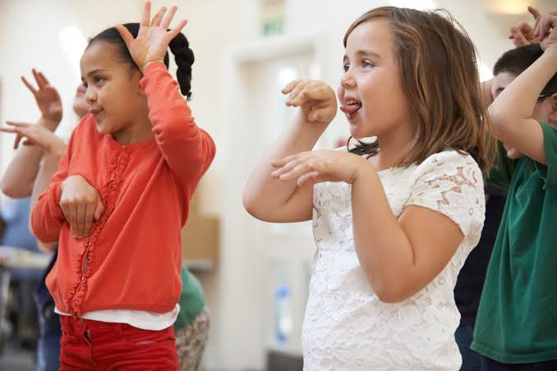
Story telling with movement
Stories that involve movement make it possible for children to physically participate in the story.

Slide 6
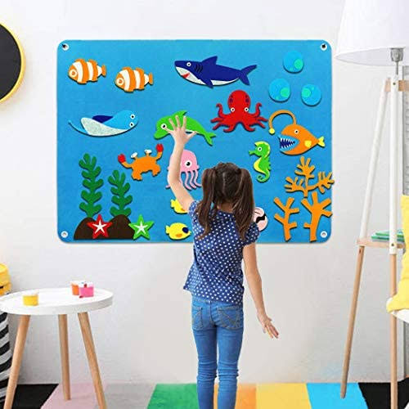
Storytelling with a magnetic board or felt board
The greatest advantage of using this method is that it makes it possible for children to tell stories in their own words and involve their favorite characters.

Slide 7
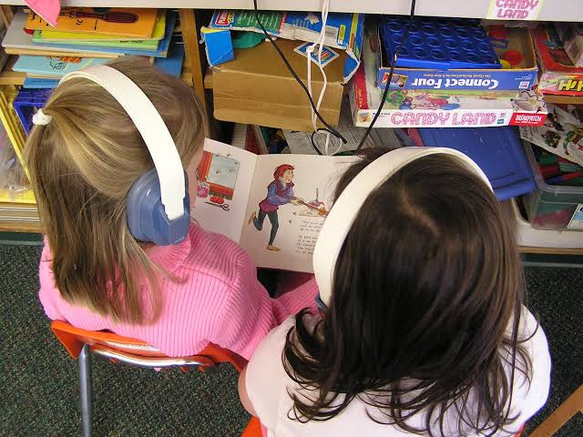
Recorded stories
This way of listening to stories helps children develop their autonomy and makes it possible for them to escape the hustle and bustle of group activities for a short while

Slide 8
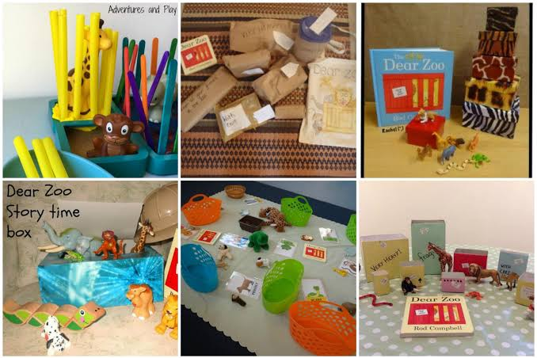
Storytelling with accessories
Fill a box with items that are mentioned in the story you wish to read to your group. As you read the story, take the items out of your box in the order they are mentioned in the story.

Slide 9
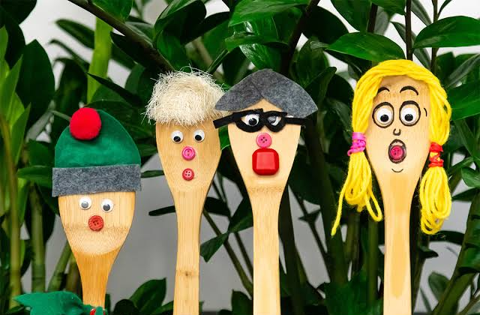
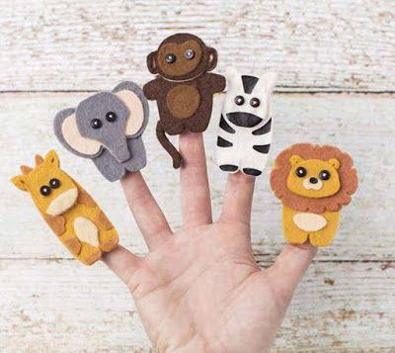
Storytelling with puppets
Dollar stores often sell all kinds of puppets. They are therefore inexpensive accessories that are sure to attract children's attention.

Slide 10
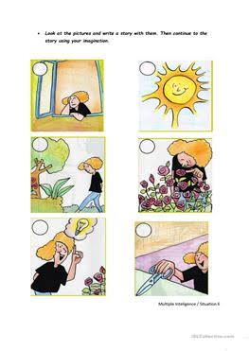
Storytelling using picture clues
Picture clue stories involve a combination of words and pictures. They are great for developing reading skills. Even if children are unable to read actual words, they can participate in the act of storytelling.

Slide 11
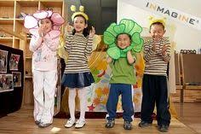
Storytelling with role play
Teacher can assign different roles to her students according to the characters of story.

