Slide 1
Preschool Professional Course
ECCE
Module 6
Time management and Stress management

Slide 2
Time Management Tips for Preschool Teachers

Slide 3
Organize the day by priorities
Teacher time management must start with setting priorities and organizing the day around the most important tasks.

Slide 4
2. Strategically plan homework assignments
Both teachers and students may find that assignments that require repetitive practice is better suited for the home environment.

Slide 5
3.Keep Lessons Simple
As teachers, we often think that every single lesson needs to be a masterpiece and that we should always go above and beyond

Slide 6
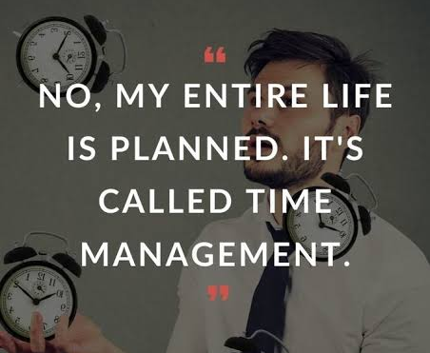
4.Get Organized
Staying organized is key to a great school year. We often spend too much time looking for supplies or papers.

Slide 7
5.Focus on Today
Every day is a new day, so embrace it and allow your students to explore, discover, and investigate the world.

Slide 8
6.Plan for potential crises
It is better to plan ahead for potential problems before facing them in the classroom, as urgent crises can distract teachers from their goals within the classroom.

Slide 9
7.Set aside personal time
When teachers are exhausted due to lack of personal care and time, it is possible that the classroom becomes less effective and efficient.

Slide 10
Stress management techniques a teacher need to know
Breathe(properly)
Embrace the stress
Be imperfect
Practice emotional first aid
Be grateful
Limit “grass is green” thinking
Work smarter , not harder
Ask for help
Make a connection

