Slide 1
Preschool Professional Course
Montessori
Module 6
Language :Zone of proximal development

Slide 2
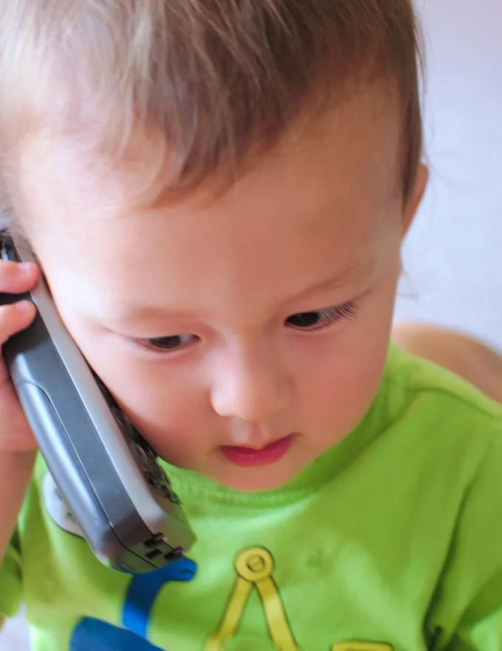
The importance of language development in early childhood
Developing language skills is of absolute importance for young children’s success later in life both as social beings and in pursuing an education.

Slide 3
What does Language means
what the word Language means.
Language is made up of words combined into sentences.
Language is used for speaking, reading and writing.
There are many different languages typically associated with different countries.

Slide 4
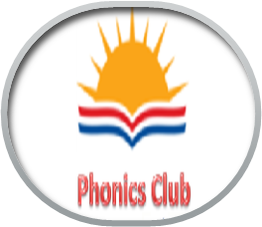
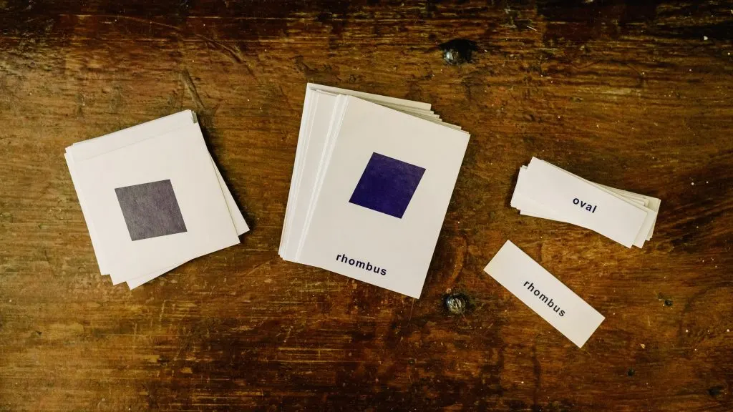
STEP 1: SPOKEN LANGUAGE There are many ways the adult can facilitate the acquisition of verbal language but we can not directly teach it. Instead, we prepare the environment. We naturally focus on offering the child rich oral language experiences.

Slide 5
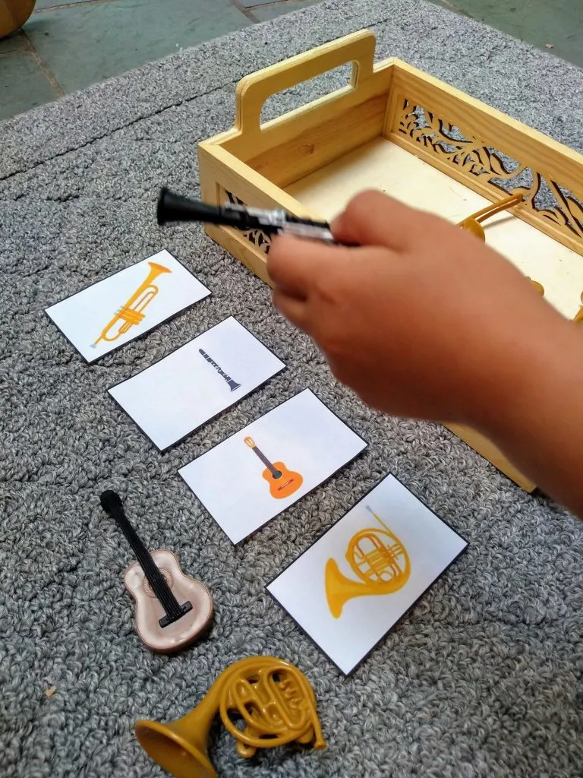
The 3-Period Lesson.
We can use the 3-period lesson to directly teach specific vocabulary for everything in the classroom and home environment.

Slide 6
STEP 2: PHONEMIC AWARENESS
We teach them the sounds of each letter and of key phonograms. We encourage them to build phonetic words, and later, they are ready, to read phonetic words.

Slide 7
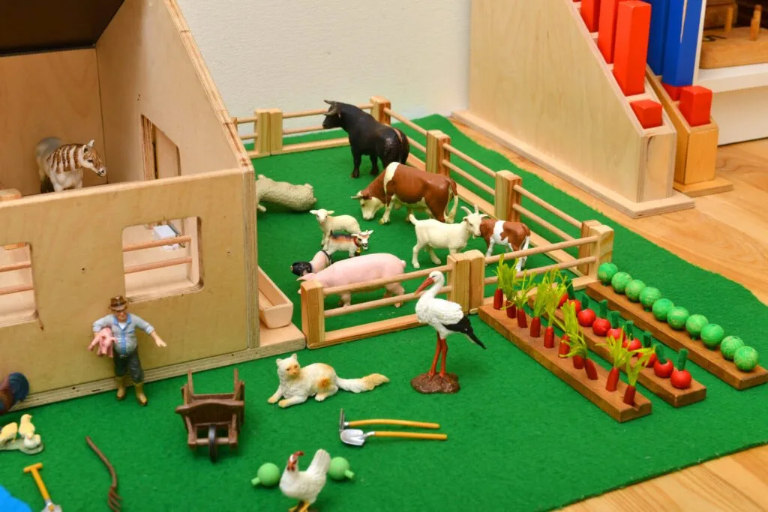
.
Materials for step 1 and 2
Vocabulary cards
Matching cards
Geography folders
Sandpaper letters
.

Slide 8
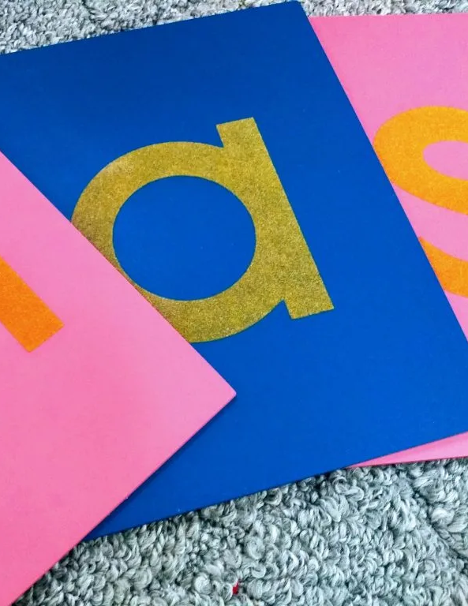
Activities
Articulating slowly and carefully
Encouraging the children to speak and pronounce words
Repeating new words
Singing songs
Reading books
Reciting poetry
Playing sound games like I Spy

Slide 9
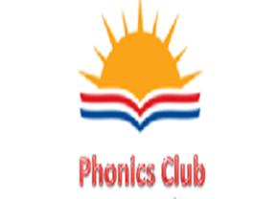
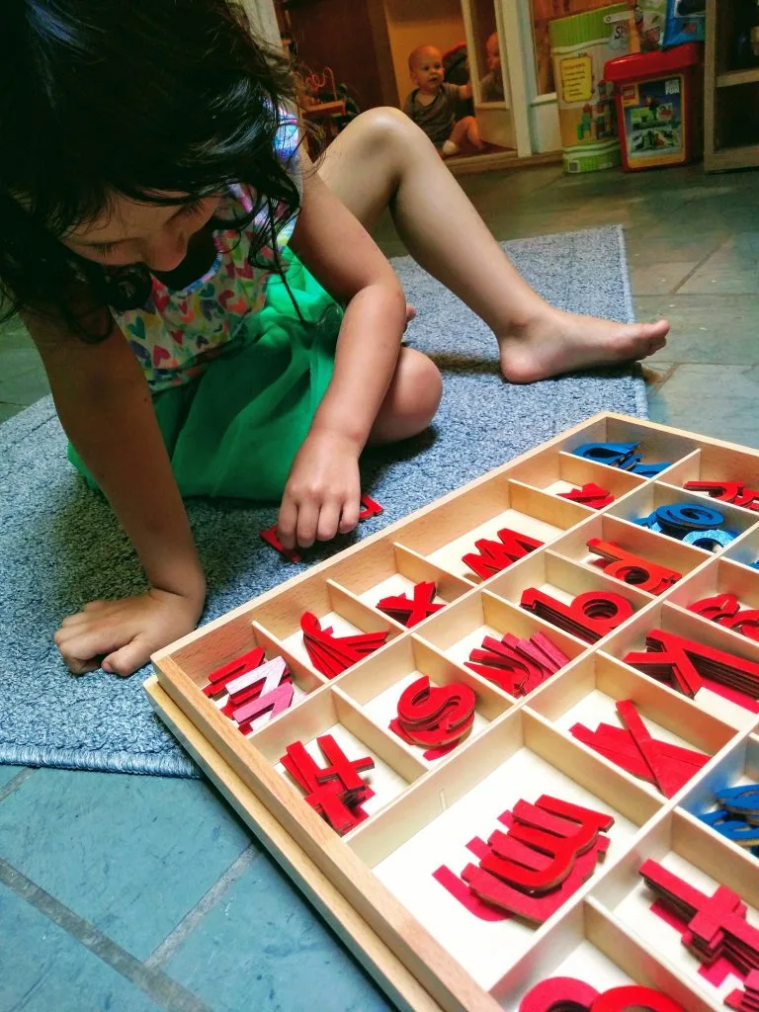
STEP 3: CREATING WORDS (WRITING)
It refers to the ability to put letters together to create a word. It can be done even if one has no muscular control of the hands. As such, this intellectual component of writing may develop even before the hand is able to hold a pencil.

Slide 10
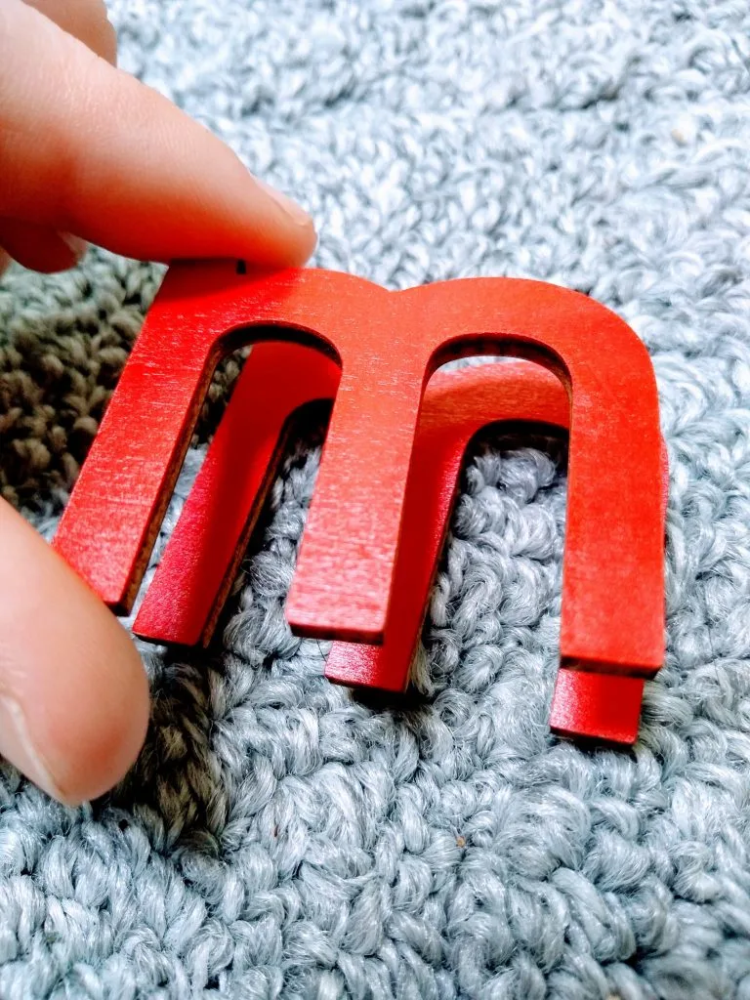
Step 3: Writing
Materials
Traditional Movable Alphabet
Phonogram Movable Alphabet
Red/Blue/Black (Phonogram) movable alphabets
Metal Insets
Chalkboards

Slide 11
STEP 4: READING
We want children not only to be able to read and understand the words of others, but to realize their own voice, to be able to read decodable and sight words.

Slide 12
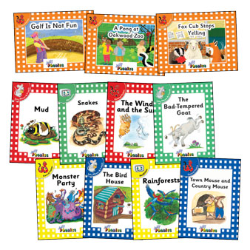
ALTERNATE MATERIALS FOR READING (step 4)
Different levels of Decodable readers of Jolly Phonics

Slide 13
The benefits of healthy language development
Foundation for all social interactions
Child’s brain development and cognitive development.
Vocabulary increases creativity
There are also numerous benefits to learning more than one language!

