Slide 1
Preschool Professional Course
Montessori
Module 4
Circle Time Classroom Dynamics

Slide 2
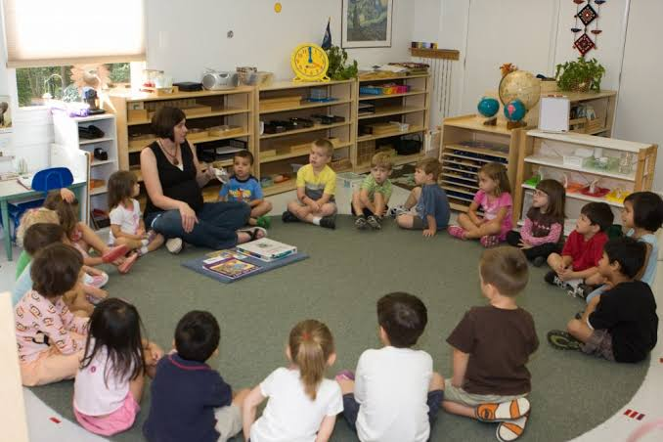
Circle Time
Circle time, also called group time, refers to any time that a group of people, usually young children, are sitting together for an activity involving everyone.

Slide 3
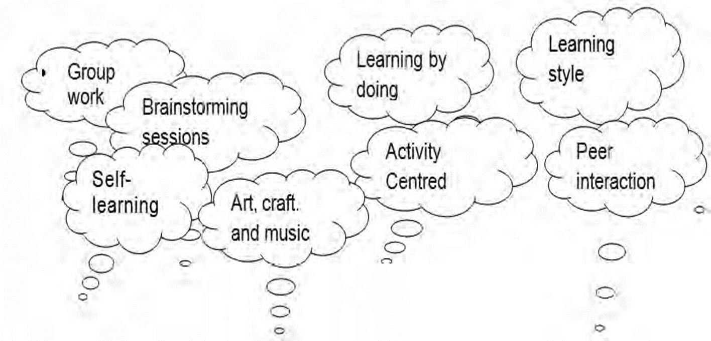
Classroom Dynamics
The circle encourages unity, respect, turn-taking and working together towards a shared vision.

Slide 4
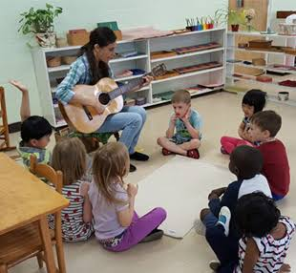
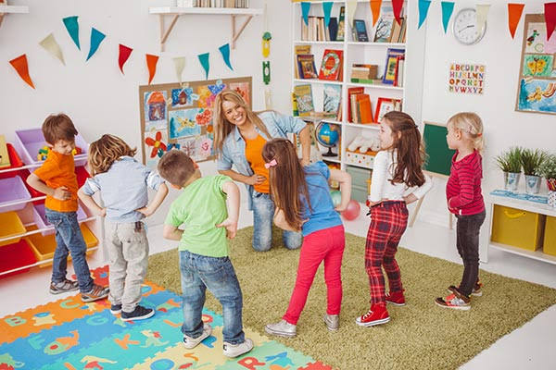
Circle Time activities
Songs
Calendar
Weather
Co-operative games,
Rounds,
Musical games,
Drama activities,
Talking and listening exercises
, Puppets and masks.
Stories
Other Language or Literacy Activities

Slide 5
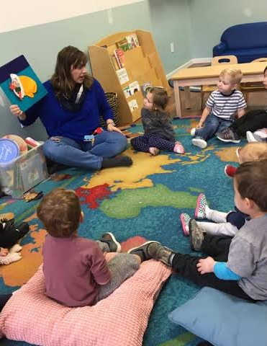
When is it used?
Ideally, it should take place weekly, and last between 20 and 50 minutes, depending on the children’s ages and ability to concentrate.

Slide 6
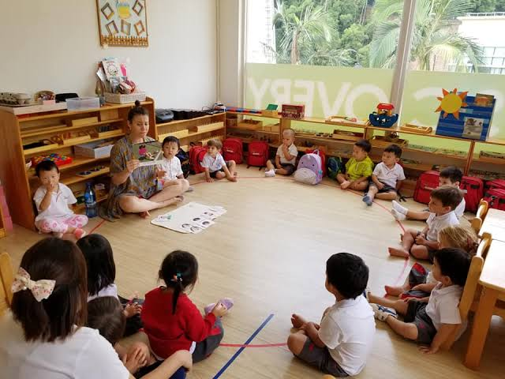
Rules
Putting hands up to speak, and not interrupting;
Taking turns;
Allowing children to ‘pass’ if they don’t want to speak;
Valuing all contributions and not putting anyone down.

Slide 7
What happens during Circle Time?
During Circle Time, children should sit in a circle, either on the floor or on chairs. Their teacher is part of the circle, too, and while they will direct the activities, they should aim to keep a low profile so children have a chance to speak up.
Often, an object like a teddy will be passed around the circle. When a child is holding the object, it’s their turn to speak.

Slide 8
.
How it should be?
Circle Time should be fun and light-hearted, and always ends on a positive note with an activity that calms children down and gets them back into learning mode.
.

Slide 9
Benefits
Improved speaking and listening skills.
Increased self-esteem.
A sense of community.
An understanding of how their behaviour affects others.
Improved emotional intelligence.
Improved problem-solving skills.
A sense of responsibility.
Improved relationships between children, and between children and their teacher.

Slide 10
