Slide 1

Preschool Professional Course
Montessori
Module 5
Eight Principles of Montessori

Slide 2


THE EIGHT KEY PRINCIPLES OF MONTESSORI EDUCATION
Movement and Cognition
Choice
Interest
Intrinsic Rewards
Connecting and Working with Others
Contextual Learning
Adult Interaction
Order in the Environment

Slide 3

Movement and Cognition
Movement has a large impact on a child’s learning and cognition. Movement is interconnected with the higher functions of mental development.

Slide 4

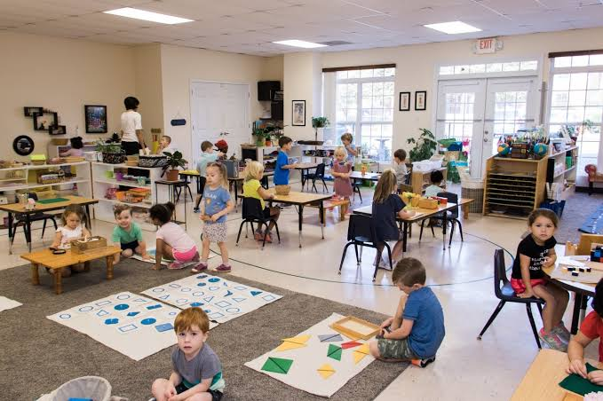
Choice
Montessori students freely choose their work and work at it for as long as they are inspired to. When they are ready, they are free to move onto any other area of focus that is of interest.

Slide 5
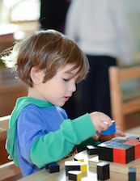
Interest
Montessori education is designed to help children discover what interests them most and to give them the freedom to learn about those things in-depth.

Slide 6
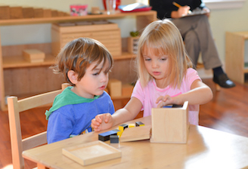
Intrinsic Rewards
Students are encouraged to study based on intrinsic motivation, rather than on extrinsic motivators such as grades.

Slide 7
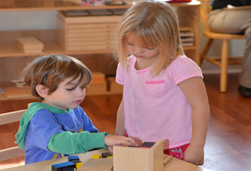
Connecting and Working with Others
Multi-age Montessori classrooms offer many benefits of leadership and mentorship.

Slide 8
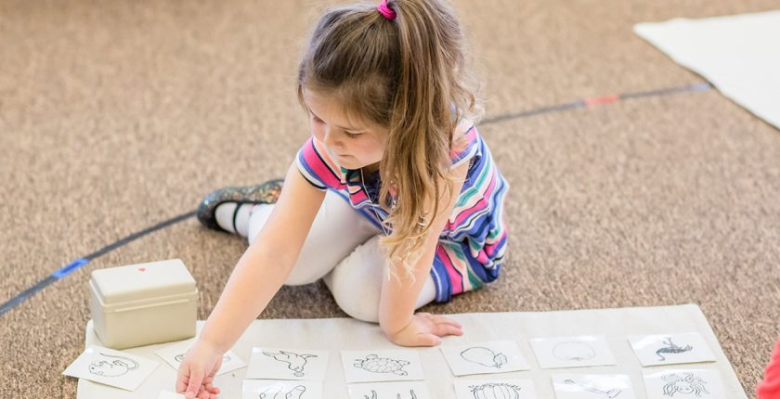

.
Contextual Learning
Children learn to think and discover on their own. Montessori materials are created to allow students to master each concept and build on their success to aid them in developing their critical thinking process.
.

Slide 9

Adult Interaction
Elementary students often work on detailed projects at school and in the community that allow them to work side-by-side with adults, developing their sense of capability, responsibility and connection in our world.
.

Slide 10
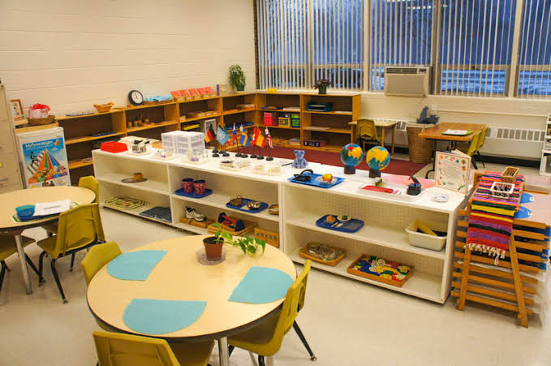
Order in the Environment
The environment is arranged in a way that maximally facilitates learning.

Slide 11
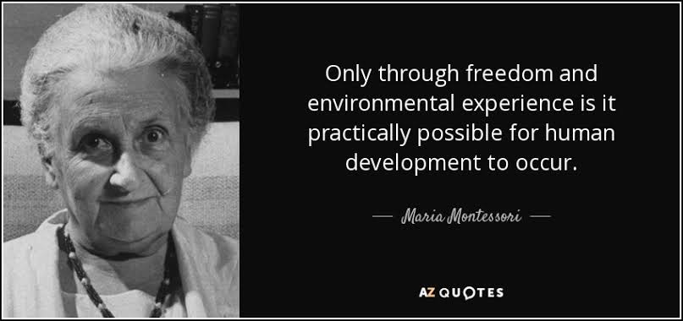

Slide 12


