Slide 1
Preschool professional
Module 1
Instructor-Sidra Rauf
Area- STEM/STEAM Education
LESSON 2: PROVIDING STEAM THROUGH INQUIRY AND PROJECT-BASED LEARNING

Slide 2
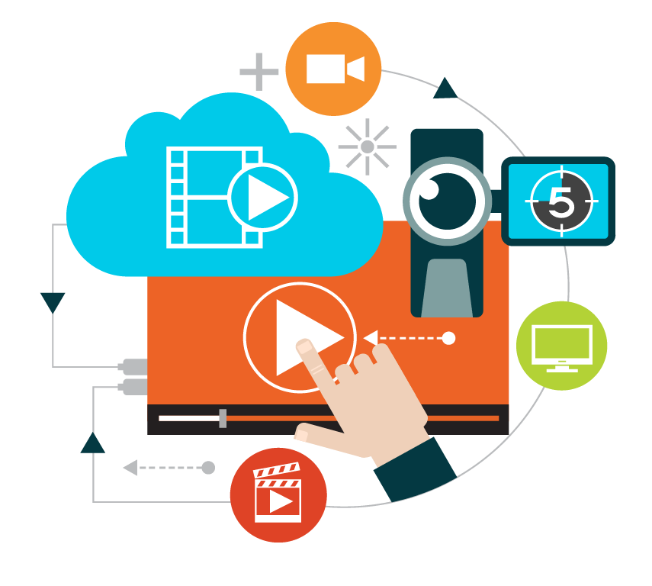
Course Content
WHAT IS PROJECT-BASED LEARNING (PBL) AND HOW DOES IT WORK?
IN STEM/STEAM, APPLYING PROJECT-BASED LEARNING (PBL).
PBL and STEAM IN PBL AND STEM, THE USE OF TECHNOLOGY

Slide 3
Course Objective
This course will enable you to:
allows you to learn about project-based learning and understand it.
enables you to see the significance of using project-based learning
PBL and STEAM usage of technology in PBL and STEAM

Slide 4
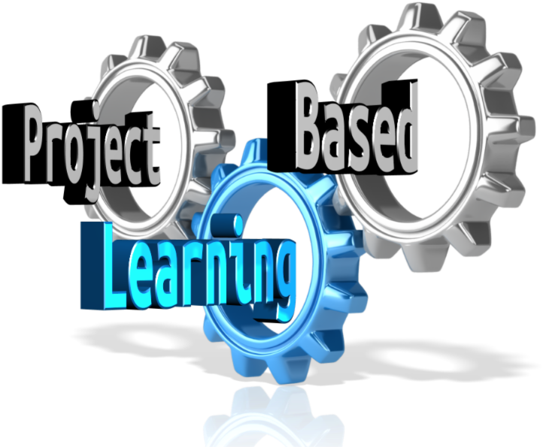
WHAT IS PROJECT-BASED LEARNING (PBL)
Students are constantly exposed to real-world problems and challenges that affect them both directly and indirectly, regardless of grade level.
Project-based learning (PBL) is a teaching style that brings learning to life, encourages student creativity and curiosity, and allows students to make connections between school and the outside world

Slide 5
WHAT IS PROJECT-BASED LEARNING (PBL)

Slide 6
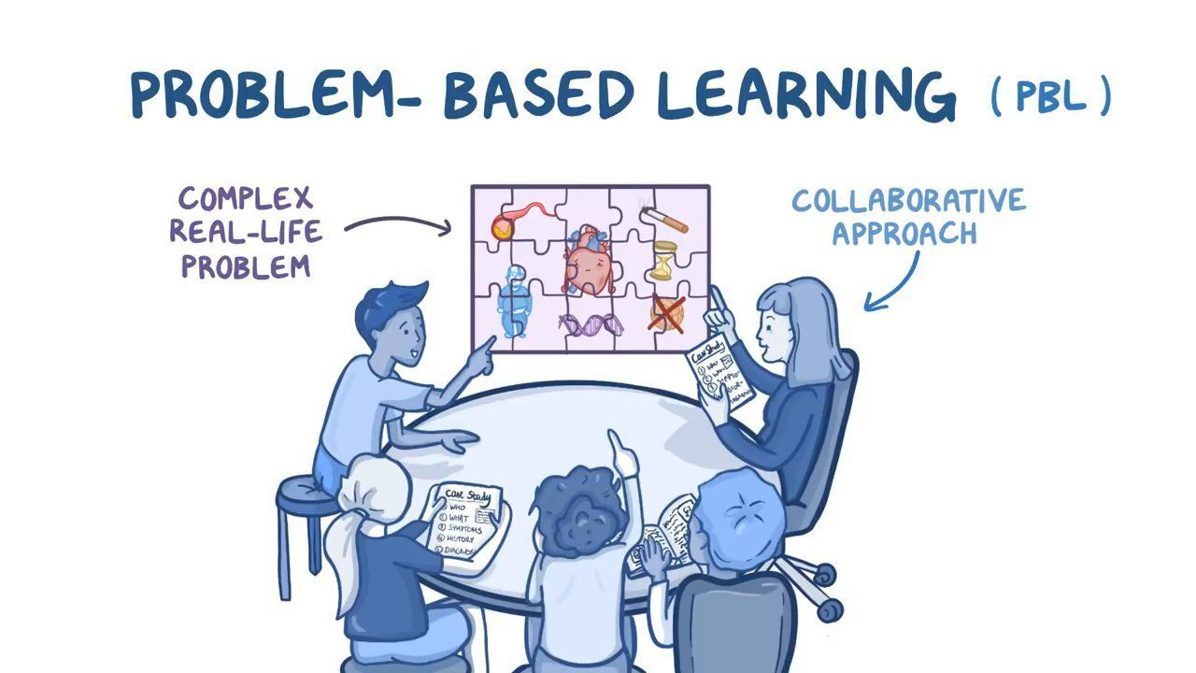
Project-Based Learning
is oriented toward the students.
The teacher serves as a facilitator and guide for the students.
begins with a provocative inquiry
is a methodical approach encourages student agency: the outcomes are determined by the student's voice and choice.
is based on real-world applications, with learning at the fore front.
is applicable to all subjects.
encourages critical thinking and inquisitive thinking.

Slide 7
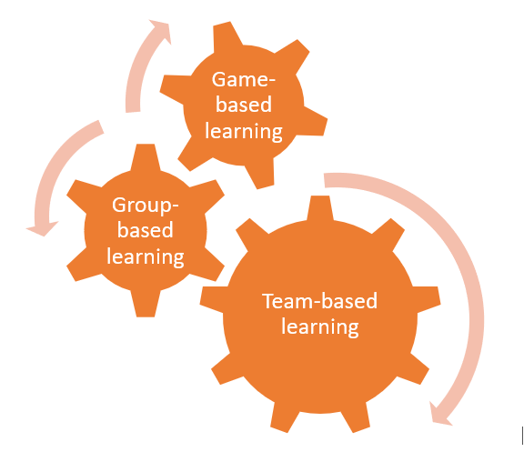
Who Can Benefit from Project-Based Learning?
All students benefit from project-based learning because it fosters critical thinking and problem-solving abilities. Collaboration, communication, soft skills, and reflection are also utilized.

Slide 8
Let’s “THINK”
Consider your own classroom for a moment. Consider the various pupils in your class, as well as their various abilities and personal characteristics. Can you conceive of somebody for whom PBL would not work, based on everything we've discussed thus far? PBL works in even the most difficult classrooms and schools!

Slide 9
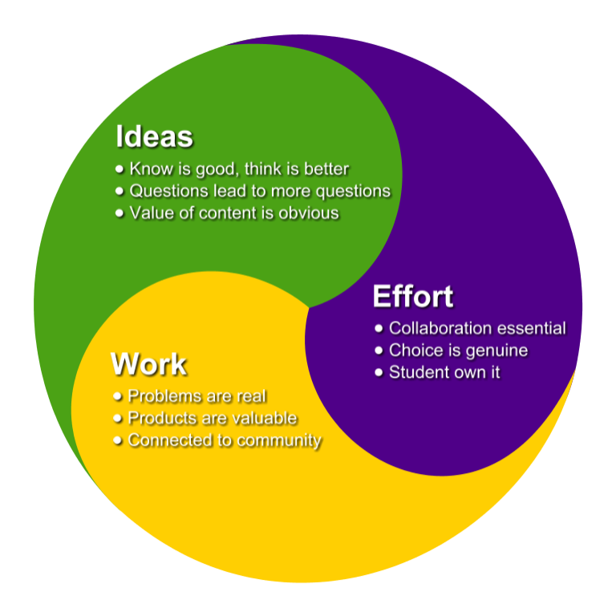
APPLYING PROJECT-BASED LEARNING (PBL) IN STEM/STEAM
What are STEM and STEAM, and why are we developing such fascinating and comprehensive programs in our schools?
STEAM (Science, Technology, Engineering, and Mathematics) programs:
Encourage our children to think creatively and critically, create opportunity for our students to think collaboratively, allocate time for students to work in teams, provide a safe place for our students to experiment, fail, and try again, and provide so many more benefits!

Slide 10
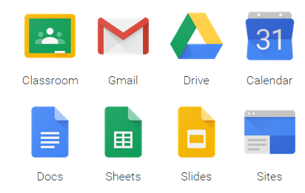
THE USE OF TECHNOLOGY IN PBL AND STEM.
The majority of the time, schools use technology in the form of:
(i.e., desktop computers, laptops, tablets, e-readers, etc.)
Computer software (i.e.,
Adobe Suite programs, Google docs, blogs, etc.)
Apps are a type of software
(i.e., Various apps that allow for secure student communication)

Slide 11
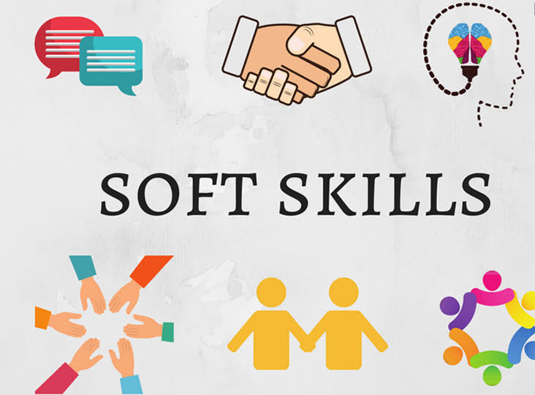
THE USE OF TECHNOLOGY IN PBL AND STEM.
While soft skills are an important component of 21st-century talents, technology is frequently the first thing that comes to mind when it comes to educating our pupils for the future.

Slide 12
Thank You

