Slide 1
Preschool Professional
Module 1
Instructor-Sidra Rauf
Area- STEM/STEAM Education
LESSON 2: AN INTRODUCTION TO STEAM INQUIRIES & LESSON PLANNING part 2

Slide 2
Course Content
STEAM Inquiries stages are essential to your STEAM inquiry's design process in order to better their project or product!
Challenge of the Paper Ball Run

Slide 3
Course Objective
This course will enable you to:
able to deliver STEAM Inquiries stages are essential to your STEAM inquiry's design process in order to better their project or product!
able to design Challenge of the Paper Ball Run

Slide 4
Inquiries about STEAM
There are various ways to build a STEAM inquiry, but the best courses frequently share a few key elements that help students achieve their goals.
Students enjoy project-based learning because it allows them to use their imagination to solve problems by combining things in new and fascinating ways.

Slide 5
Consider the following steps as the foundation of your STEAM inquiry planning:
THE DESIGN PROCESS SHOULD BE THE CENTER OF ATTENTION.
THERE SHOULD BE ROOM FOR CREATIVE SOLUTIONS TO THE PROBLEM.
IS THE PROBLEM TO BE SOLVED BASED ON AN EXAMPLE FROM THE REAL WORLD?
IN WHAT WAYS ARE MATH AND SCIENTIFIC THEORY INCLUDED IN THE LESSON?

Slide 7
IN WHAT WAYS ARE MATH AND SCIENTIFIC THEORY INCLUDED IN THE LESSON?
From the start, try to incorporate math and science into your lecture, for example:
What is the Theory behind the design?
What criteria are the students using to evaluate their performance?
What kind of information could or should we gather?
What exactly does the information gathered imply?
What can we learn about our design from the data?

Slide 8
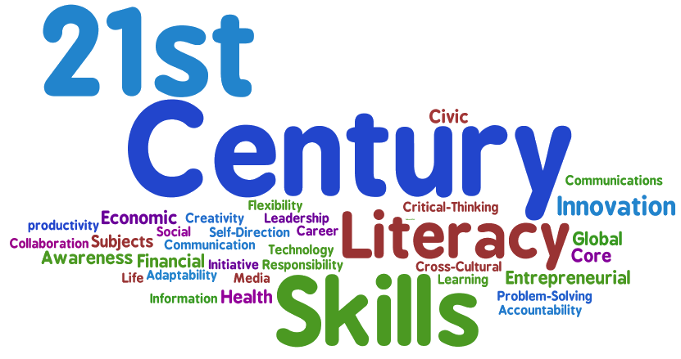
WHAT SKILLS ARE BEING DEVELOPED FOR THE 21ST CENTURY?
What 21st-century skills, for example, are being cultivated as part of the lesson:
Shared accountability, flexibility, and respect for individuals and groups are all examples of collaboration
Communication: the ability to express oneself verbally, in writing, and nonverbally
Critical Thinking/Problem Solving: the ability to communicate ideas verbally, in writing, and nonverbally.
Creating, evaluating, and recombining ideas and products to solve a problem or improve something is creativity/innovation.

Slide 9
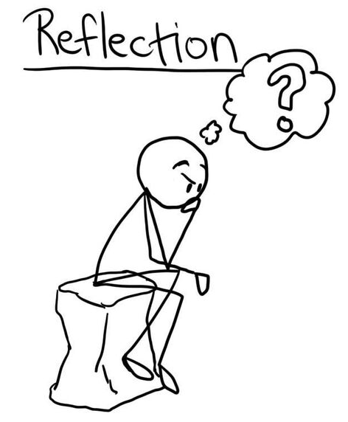
IS THERE ROOM FOR REFLECTION AND CONVERSATION?
Reflection and consideration of what has been learned and why it has been learned is an important aspect of the design process and of STEAM teaching. Consider the following:
fresh knowledge or mastery of a concept.
Failures teach us new things.
Misunderstandings are clarified.
And, more importantly, what not to do next time!

Slide 10
HOW IS THE LESSON ASSESSED, FIRST AND FOREMOST?
Make a decision about how the student's work will be evaluated.
Develop evaluation criteria based on the educational standards connected with each subject.
Consider what part of the project is related to each subject and what "concrete" record will be used to evaluate it.
Remember to give the method as well as the outcome equal weighting.
Place a 60 percent value on the process and a 40% value on the product.

Slide 15
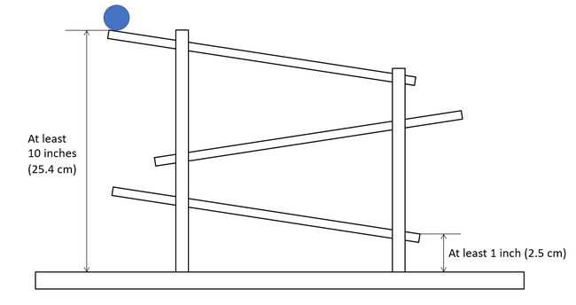

Slide 16
Thank You

