Slide 1
Preschool Professional
Module 1
Instructor-Sidra Rauf
Area- STEM/STEAM Education
LESSON 3: STEAM LESSON OUTCOMES AND ASSESSMENTS PART 1

Slide 2
Course Content
For, as, and of Learning Assessment
ASSESSMENT FOR LEARNING
ASSESSMENT AS LEARNING
ASSESSMENT OF LEARNING
Principles of effective assessment

Slide 3
Course Objective
This course will enable you to:
Understand
EVALUATION FOR LEARNING
EVALUATION AS LEARNING
EVALUATION OF LEARNING
Principles of effective assessment

Slide 4
For, as, and of Learning Assessment
A key element of the teaching and learning process is assessment.
A key element of the teaching and learning process is assessment.
Students can determine whether existing understanding is a good foundation for future learning with the use of assessment for learning and assessment as learning methodologies.

Slide 5
The fundamentals of assessment as a learning tool and as a learning strategy
Assessment of learning and assessment of learning include:
Self-assessment and peer assessment
Ways for pupils to actively track and assess their own progress.
Comments and supporting documentation to aid teachers and students in determining.
If a student is prepared for the next level of learning.
To solidify their knowledge, understanding, and abilities, individuals require additional learning opportunities.

Slide 6
Assessment for Learning
Reflects a perspective on learning in which assessments serve to improve learning rather than just help pupils get better grades.
Combines both formal and informal assessment processes as a component of learning and to guide future learning planning.
Sets specific objectives for the educational activity

Slide 7
ASSESSMENT AS LEARNING
Empowers pupils to be in charge of their own education
Encourages inquiries regarding learning from the students
Involves setting learning objectives with students and teachers to promote development
Outlines how to utilize self-evaluation, official feedback, and informal feedback to help students identify their next stages in learning.
Fosters contemplation, self-reflection, and peer assessment.

Slide 8
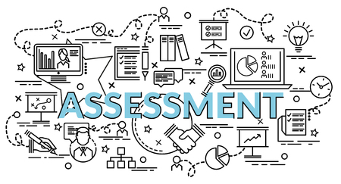
ASSESSMENT OF LEARNING:
Is used to create learning objectives and pathways for students in the future.
Demonstrates success to the larger community, including parents, teachers, students, and outside groups.
Assures accurate interpretation for all audiences.

Slide 9
The multiple layers of assessment's goal include:
Possibilities for teachers to collect data on student performance in connection to curriculum objectives.
Permits students to show what they understand and are capable of.
Helps students understand ideas more clearly and encourages deeper learning.
Demonstrates that present knowledge is a sound foundation for future learning.

Slide 10
The following criteria and procedures are essential when designing assessments:
Be based on a combination of syllabus results and curricular subject standards.
Allow pupils to show their understanding in a variety of activity kinds.
Measure the performance being evaluated, and give precise information on each student's progress.

Slide 11
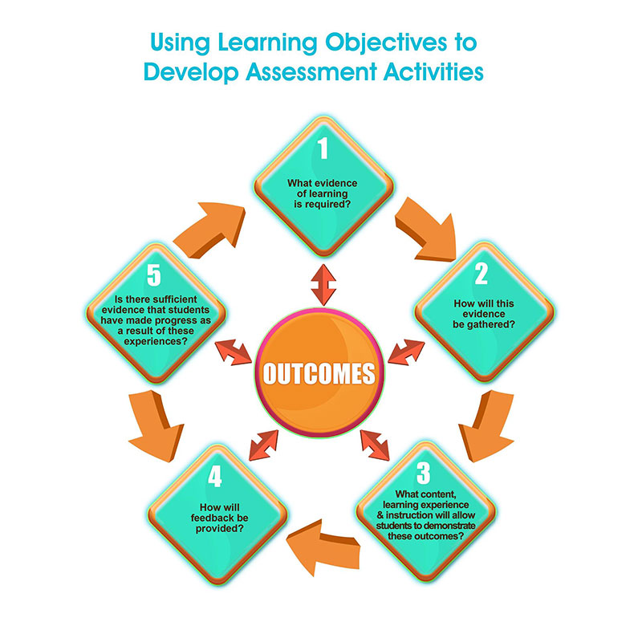

Slide 12
Teachers use learning objectives when creating assessment opportunities and activities to:
Be based on a combination of syllabus results and curricular subject standards.
Allow pupils to show their understanding in a variety of activity kinds.
Measure the performance being evaluated, and give precise information on each student's progress.

Slide 13
Teachers use learning objectives when creating assessment opportunities and activities to:
Design and create chances for learning and assessment.
Track the development of the students at each level.
At each level, evaluate student performance in relation to the planned learning.
Report on a stage's growth and accomplishments of the students.
Evaluate the development and progress.

Slide 14
Thank You

