Slide 1
Preschool Professional
Module 1
Instructor-Sidra Rauf
Area- STEM/STEAM Education
LESSON 4: KEEP YOUR STEAM ROADMAP READY part1

Slide 2
Course Content
Create a roadmap for STEAM integration & Development of a STEAM road map.
STEAM Technology Integration
External STEAM
Internal STEAM

Slide 3
Course Objective
This course will enable you to:
Create a roadmap for STEAM integration & Development of a STEAM road map.
STEAM Technology Integration
Internal STEAM
External STEAM

Slide 4
Create a roadmap for STEAM integration
The road map for attaining the academic objectives of teachers and students is an effective, scaffold lesson plan.
We now examine how to organize and incorporate several STEAM lessons into a year's worth of lesson plans.
A roadmap is essential for planning the integration of STEAM lessons into the curriculum to enhance the delivery of knowledge.
Skill development based on the main learning objectives and standards.

Slide 5
Building a STEAM Roadmap entails creating a framework with the following goals:
Verify your STEAM objectives and involvement.
Draw attention to the difficult subjects in your curriculum and use them as focal points for additional STEAM courses that will help the lessons you offer to be more effective.
Make a schedule for the development of the program.

Slide 6
Building a STEAM Roadmap entails creating a framework with the following goals:
Make sure teachers have the time and resources they require to conduct lessons effectively.
Prepare your classroom (or institution) for STEAM.
Budget and resources are distributed
Time spent mapping is crucial because there is no one, perfect pathway.
Time spent mapping is crucial because there is no one, perfect pathway.

Slide 7
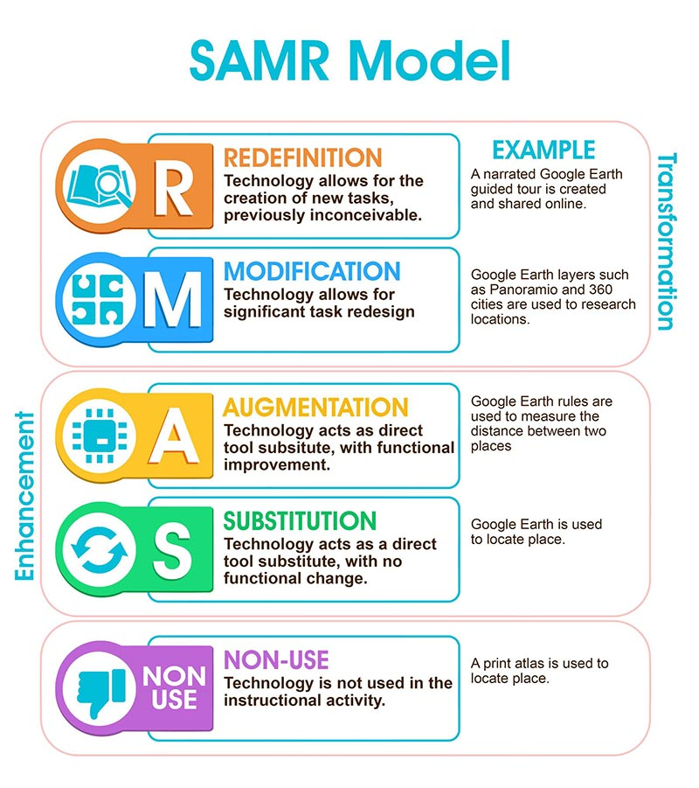
STEAM Technology Integration
The SAMR model is a useful technique for evaluating how well technology, such as laptops or tablets, are being used.

Slide 8
Integrating STEAM into the School
The following tables give a general summary of what students, instructors, and schools are doing as they work to incorporate STEAM into their teaching and learning at three different phases of immersion.
It is significant to keep in mind that teachers, schools, and students may be situated at various positions along the continuum. To determine where your school community is right now and to assist choose the next steps, use the points as a checklist.

Slide 9
EXTERNAL STEAM

Slide 10
INTERNAL STEAM

Slide 11
INTEGRATED STEAM

Slide 12
Thank You

