Slide 1
Preschool Professional Course
Montessori
Module 7
Mathematics ;counting shapes operations

Slide 2
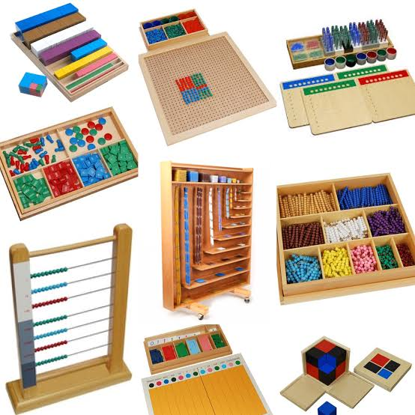
Montessori Mathematics
Montessori believed that a child’s mind is mathematical and based on the order of perceptual awareness found in the development of the senses.

Slide 3
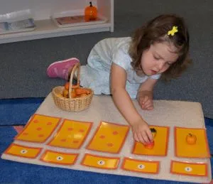
System
The Montessori Math includes the development of concepts such as numeration, place value, fractions, and the basic operations of addition, subtraction, multiplication, and division using numbers up to 9999.

Slide 4
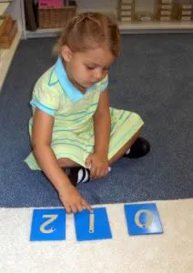
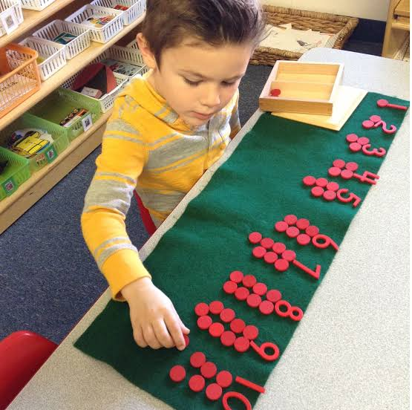
Learn Counting
By learning the names “one-ten”,
child being able to place the correct quantity (number) with the appropriate symbol (numeral). Basic materials used for learning this concept are Number Rods, Sandpaper Numerals, Spindle Boxes, and Cards and Counters

Slide 5
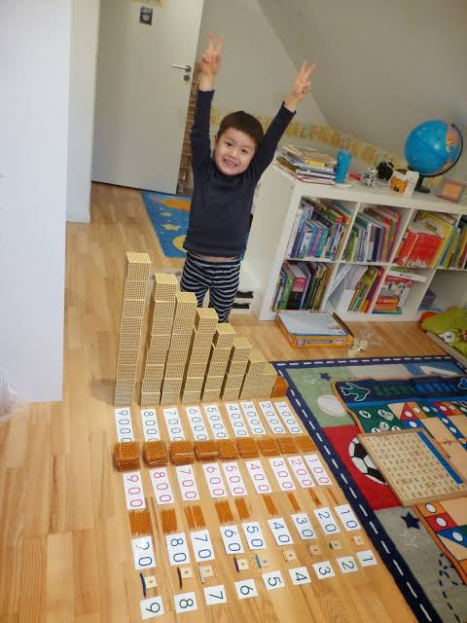
the child is able to move on to working with 9 units, 9 hundreds, 9 tens, and 9 thousands.
Tables
The child is also presented with the basic facts of the four operations, sometimes called the Tables.

Slide 6
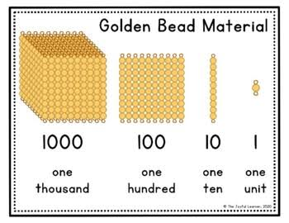
Four Operations
Child gains an understanding that addition means to join together, subtraction means to take away, multiplication means to join the same quantity many times, and division means to share equally.
The Golden Bead Material or The Decimal system.

Slide 7
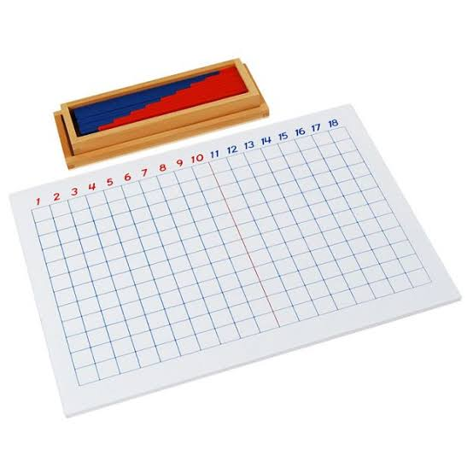
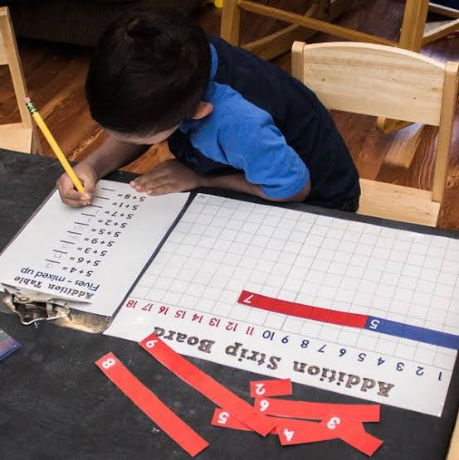
.
ADDITION
With a special board called the Strip Board, the child practices each addition table and also learns about the Commutative Principle (5+2=2+5).

Slide 8
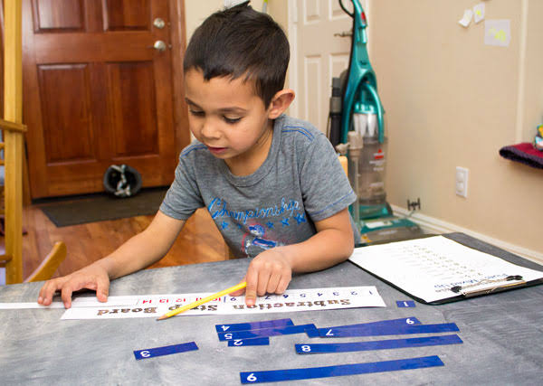
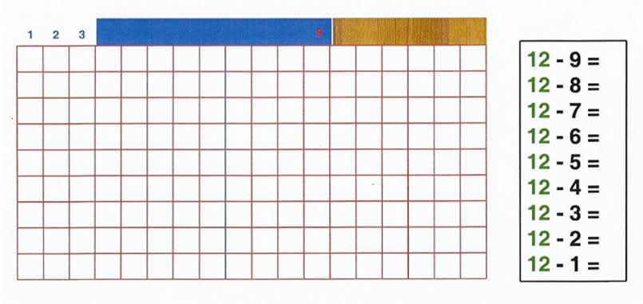
Subtraction
There are math materials for practicing the subtraction tables (18-9=9; 17-9=8, 17-8=9; e t c, based on the reverse of the addition facts)

Slide 9
Multiplication
The multiplication basic facts going from 1×1=1 through all the multiplication tables to 10×10=100. With all of the work on the basic arithmetic facts, the child uses bead bars, numerous tables and charts, and strips with printed equations.

Slide 10
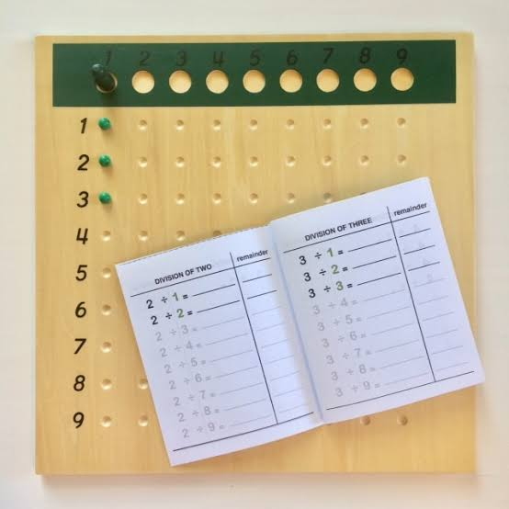
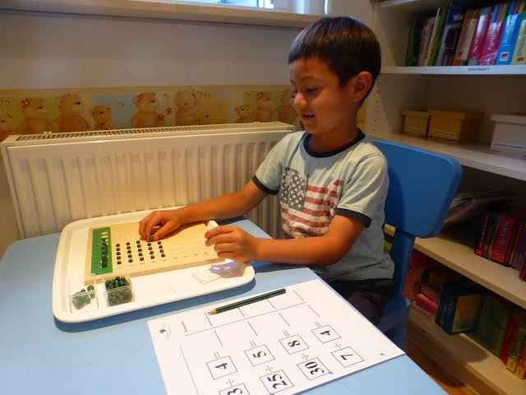
Division
The concept of division is presented and practiced by sharing unit beads among up to 9 skittles. Actually learning the division facts in an order is usually left to the future elementary grades.

Slide 11
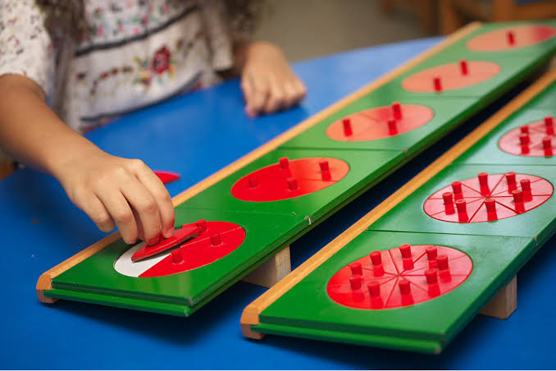
Fractions
Halves, thirds, and fourths are also introduced, and the children learn first to identify these fractions and then to add and subtract fractions of like denominators.

Slide 12
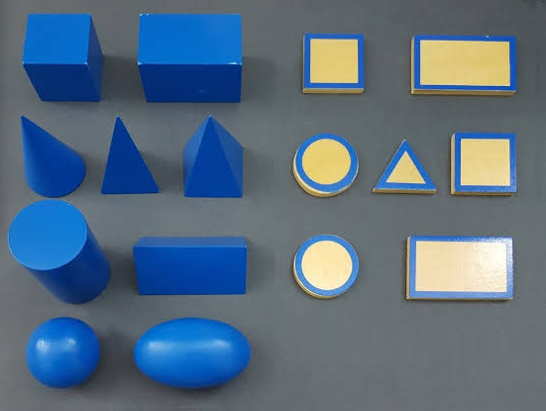
Shapes

Slide 13
